Slide 1
MVC and Databases
Part 1 – Main functionality

Slide 2
Before you begin
You should have installed
Visual Studio Community 2016 (the 2017 version still has some problems)
SQL Server Express 2016 (at the moment, SQL Server 2017 databases can’t be deployed to our hosting service) and SQL Server Management Studio (2016 or 2017)
You should have worked through the C# material and be comfortable with writing console applications in C#, including object-oriented programs
You should have some knowledge of HTML and CSS
You should have worked through the introductory MVC material, including the first MVC tutorial without a database (this is in Chapter 2 of the MVC book by Adam Freeman)
You should have a core understanding of relational databases

Slide 3
The Project

Slide 4
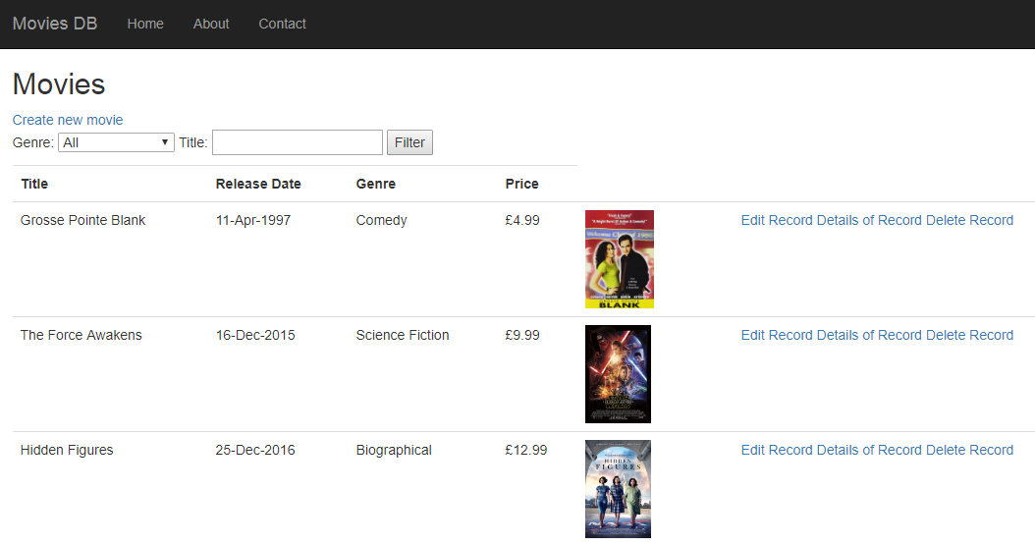
Movie Application
Requirements
This is an MVC5 application with a single-table SQL database
It has Create, Read, Update and Delete (CRUD) functionality
It has filtering and searching
A database-first approach is used to create the database, which is then attached to the project by creating an ADO.NET Entity Framework model

Slide 5
The Architecture

Slide 6




ADO.Net
Model
Http request
Routing engine
Controller
Http response
Views

Slide 7
The Workflow

Slide 8
Requirements
Design and Create the Database
Connect to SQL Server using SSMS
Create DB
SDLC
Review Requirements
Design Solution
Implement Solution
Project Management
Create Project
In Visual Studio create project
ADO.Net Entity Data Model
Setup Environment
SQL Server 2016 Express
SSMS
Visual Studio Community 2016
Test Connections
Build Application
Create Model
Create Controllers
Create Views
Test
Deploy Application
Connect to Smarter ASP.Net
Add Database
Create Folder Container
Publish Application from Visual Studio

Slide 9
Create the SQL Server Database

Slide 10

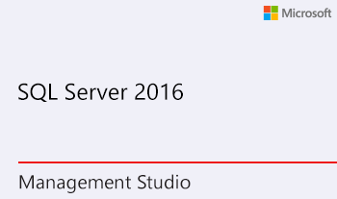
  https://www.microsoft.com/en-gb/sql-server/sql-server-editions-express

Slide 11
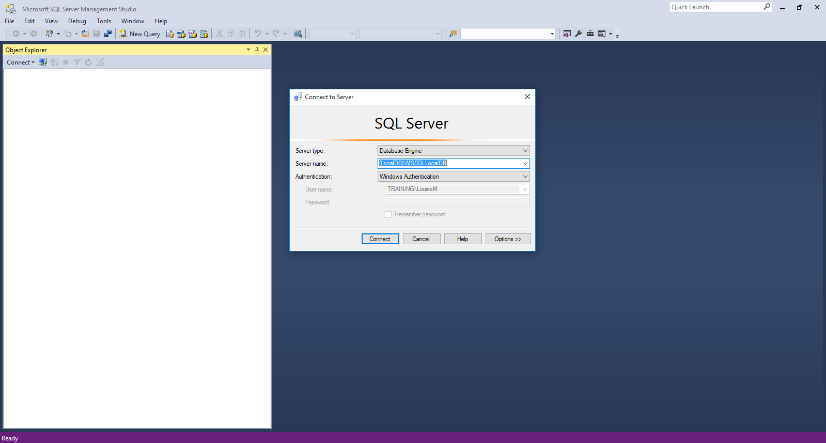
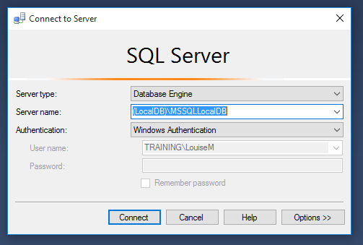
Open SQL Server Management Studio
Start SQL Server Management Studio and connect with the following credentials:
  Server type: Database Engine
  Server name: (LocalDB)\MSSQLLocalDB (type this in if it isn’t in the list of options)
  Authentication: Windows Authentication
If you get an error here, see the instructions at the end of the database slides

Slide 12
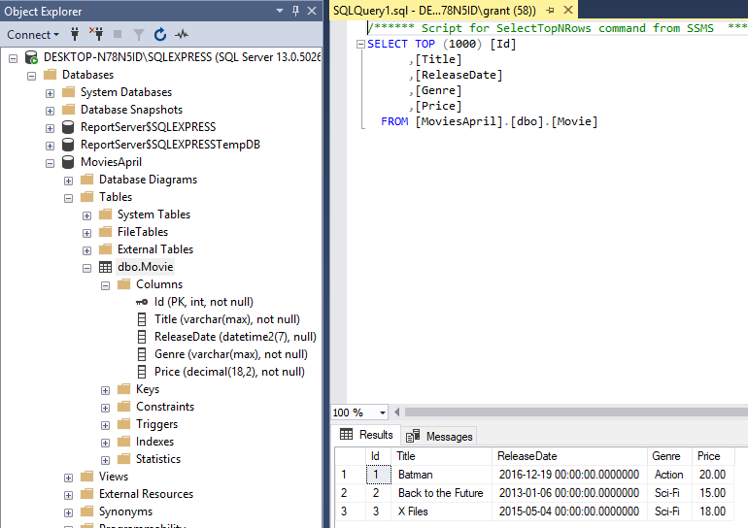
Using SQL Server Management Studio
To Attach a Database
In SQL Server Management Studio Object Explorer, connect to an instance of the SQL Server Database Engine, and then click to expand that instance view in SSMS.
Right-click Databases and click Attach.
In the Attach Databases dialog box, to specify the database to be attached, click Add; and in the Locate Database Files dialog box, select the disk drive where the database resides and expand the directory tree to find and select the .mdf file of the database; for example:
C:\Program Files\Microsoft SQL Server\MSSQL13.MSSQLSERVER\MSSQL\DATA\AdventureWorks2012_Data.mdf
Important
Trying to select a database that is already attached generates an error.

Slide 13
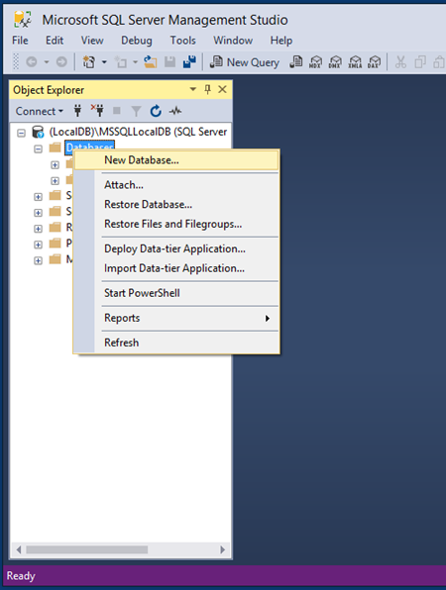
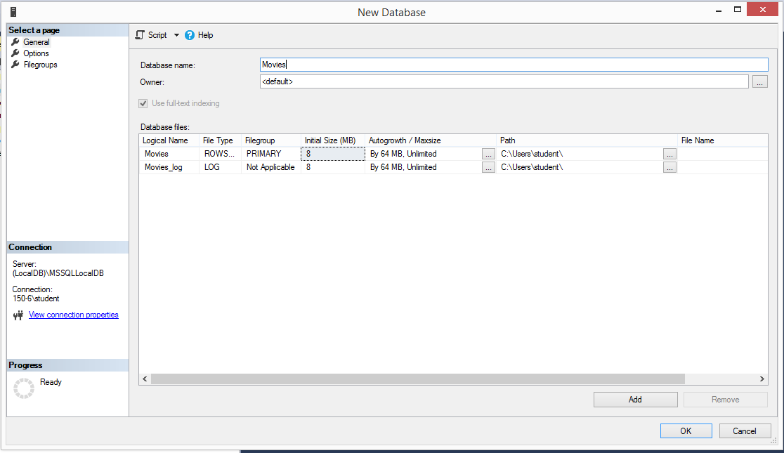
SSMS – creating a database
After logging in, right-click on the Databases folder in the Object Explorer
Select New Database …
In the New Database dialog
  Enter Movies as the name of your database
  Expand the dialog to the right to check where the database file will be saved (it’s usually in the folder C:\Users\[your username]) – you will need to know this later
  If you change the location, make sure that both files are being saved in the same place (one is the data file and the other is the log file)

Slide 14
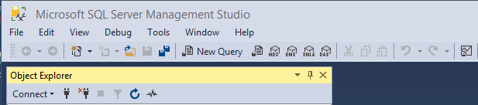
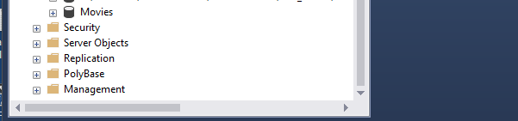
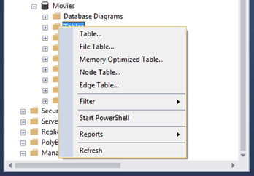
Creating the database table
You should now be able to see your database in the Object Explorer under the Databases folder
  If it doesn’t appear, click the Refresh button until it does
Expand the node with your database name on it
Right-click on the Tables folder and select Table…
  This takes you to the design window

Slide 15
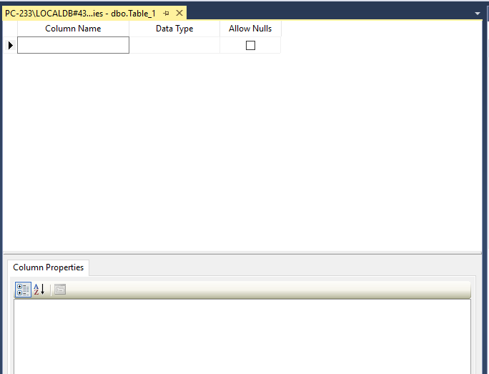
Database designer
You will now see the database design window
Here you will enter details of the columns you want to have in your Movies table
Each column will have a name and a data type and you will choose to allow or not allow nulls
  Some columns, such as the primary key, need some extra information

Slide 16
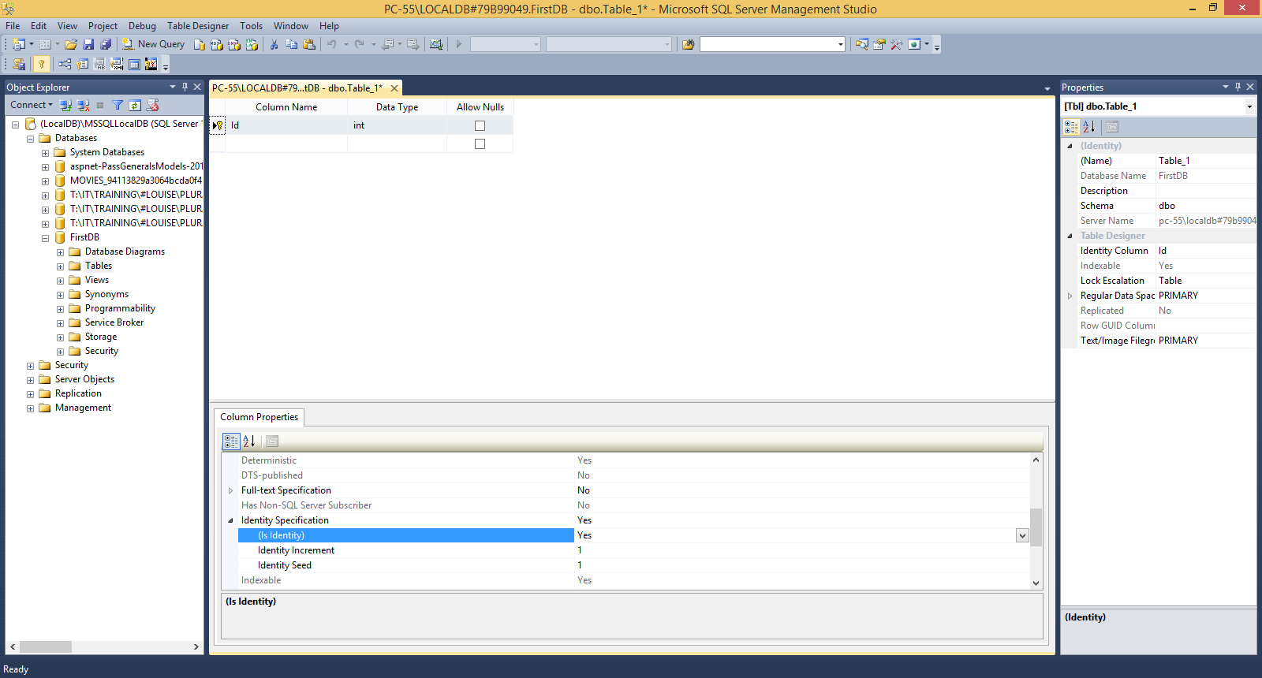
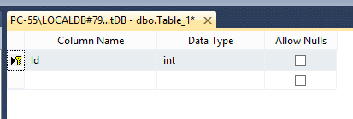
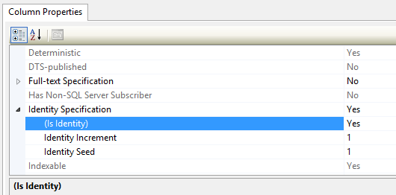
Setting up your primary key
Every database table must have a primary key
  This identifies each record in your table so that the database software can find it
  A correctly set up primary key is essential for using the ADO.NET Entity Data Model to connect your database to your code
The primary key should be:
  Called Id (or [TableName]Id), with no spaces in the name
  Int data type
  Nulls not allowed
To complete the setup of your primary key:
  Right-click on the black triangle next to it and select ‘Set primary key’ from the menu. A yellow key will appear next to the triangle
  Go into the Column Properties tab (below the table’s design details), find Identity Specification and change its values to Yes, Yes, 1, 1

Slide 17
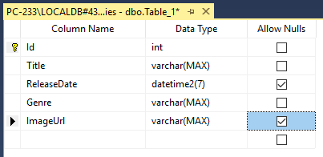
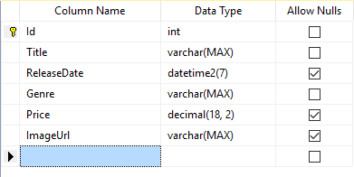
Finishing your table design
Please enter the following (if you stick to this exactly, it will make the rest of the tutorial easier):
  Id int no nulls
    Set up as primary key as on previous slide
  Title varchar(MAX) no nulls
  ReleaseDate datetime2 nulls allowed
  Genre varchar(MAX) no nulls
  Price decimal(18,2) nulls allowed
  ImageUrl varchar(MAX) nulls allowed
Data types in SQL and C#:
  int = int
  varchar(MAX) = string
  decimal(18,2) = decimal (with 2 decimal places – you can overtype the numbers if you want more or fewer decimal places)
  datetime2 = DateTime (recommended as it doesn’t crash if a zero date is accidentally set)
Tips for adding columns to your table
  Avoid spaces in column names
  Think about whether you want to allow null values
    Allowing null values is recommended for dates, as there is a bug in Google Chrome that sometimes wipes dates. Allowing nulls will help prevent your code crashing
    Don’t allow nulls for primary keys!

Slide 18
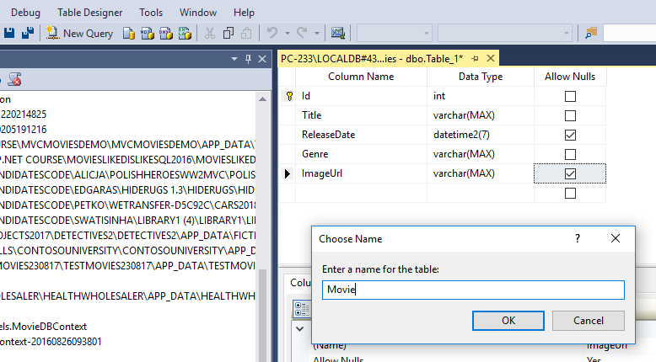
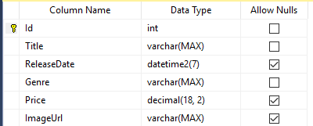
Saving your table
To save your table, click on the save button
In the Choose Name dialog, name your table Movie and click OK
  Table names should always be singular (not plural) with no spaces
You may have to click Refresh in the Object Explorer to see the table under the Tables folder

Slide 19
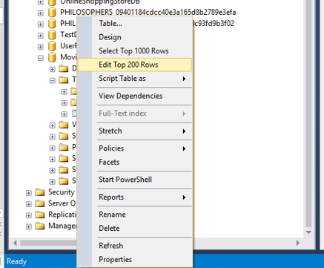
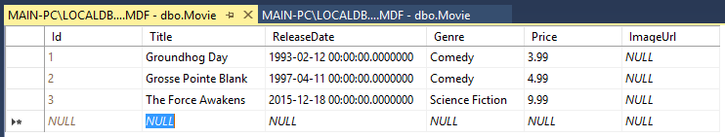
Entering data into your table
If you have trouble entering dates, then use a yyyy-mm-dd format
  The zeros are times and you don’t have to enter those – SSMS fills them in
It’s best to add some data when you create a table, so that you have some data to display when you start working on your code
Start this by right-clicking on the table in the Object Explorer
  Select Edit Top 200 Rows from the menu
You will then be able to add a few records to the table
  Don’t enter an id – SSMS will do this for you
  Tab between fields and rows
  Each record is saved when you finish a row
  You can leave ImageUrl blank for now

Slide 20
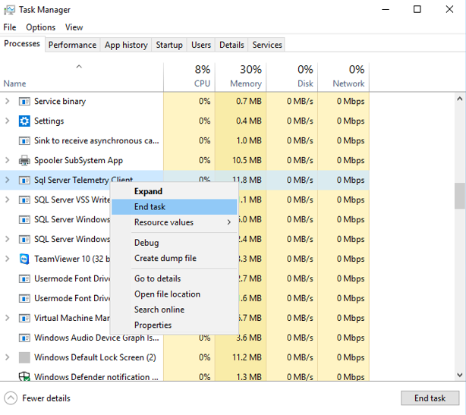
Preventing a ‘file in use’ error
Now close SQL Server Management Studio
To prevent a ‘file in use’ error when you try to use the database file in Visual Studio:
  Go to Task Manager
    Right-click on the taskbar and select it from the menu
    Or do Ctl+Alt+Delete and select it from the menu
  Close down all Background Processes that begin with SQL
    Right-click on the process and select End Task from the menu

Slide 21
Create the Project in Visual Studio

Slide 22
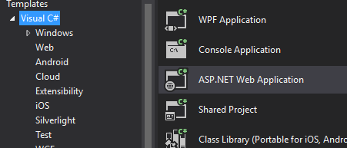
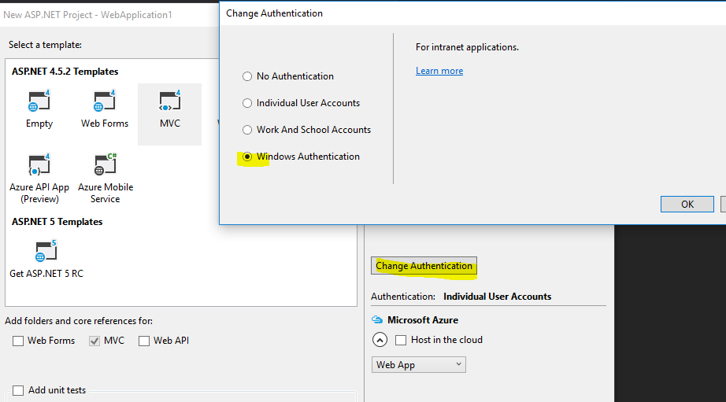
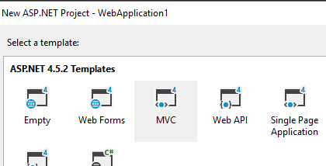
Create new MVC Project with SQL DB Authentication
New MVC Project
Authentication set to Windows (SQL Database

Slide 23
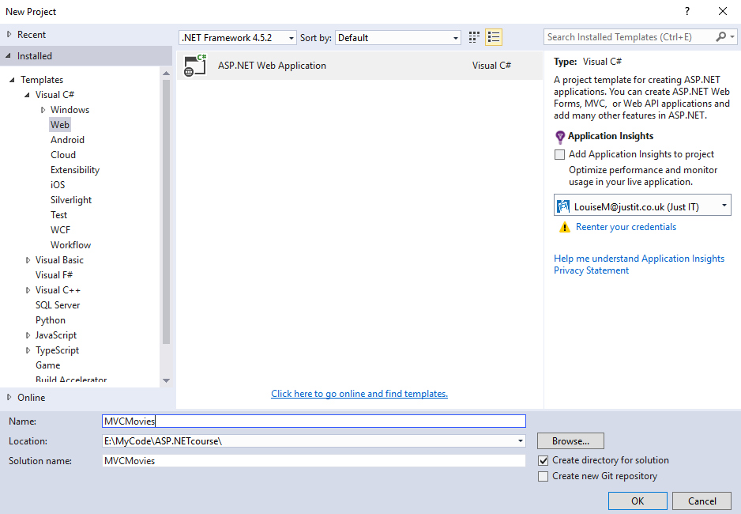
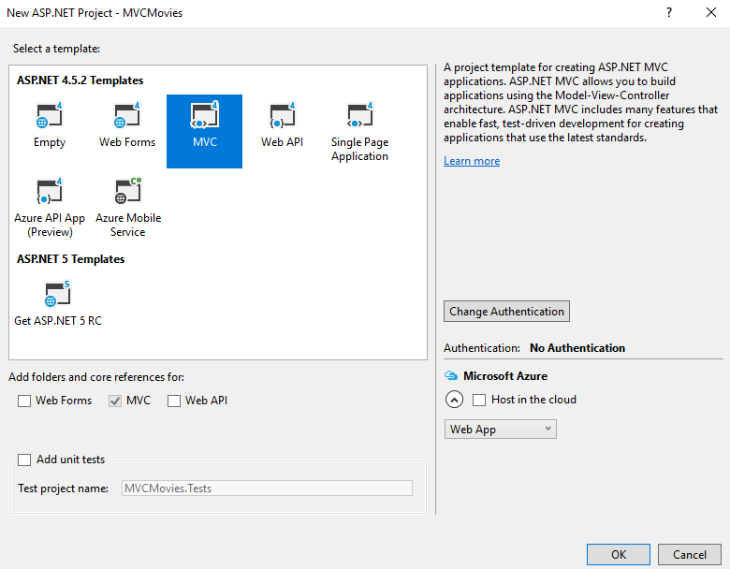
Starting a project in Visual Studio
Open Visual Studio
Start a new ASP.NET Web Application project
  Leave the Application Insights box unchecked, as it’s not relevant
On the Select a Template dialog
  Select the MVC icon with a small 4 in the top right corner
  Click the Change Authentication button and select No Authentication
  Leave Add Unit Tests and Host in the Cloud unchecked
  Click OK and wait for Visual Studio to start the project (this may take a couple of minutes, as it is assembling a lot of files)

Slide 24
Connecting the Database to the project

Slide 25
ADO.NET Entity Framework
Entity framework is an Object/Relational Mapping (O/RM) framework
It is an enhancement to ADO.NET that gives developers an automated mechanism for accessing and storing data in the database
Easy to use and saves a lot of work
Can be set up in Visual Studio

Slide 26
ADO.Net
Build an Entity Model

Slide 27
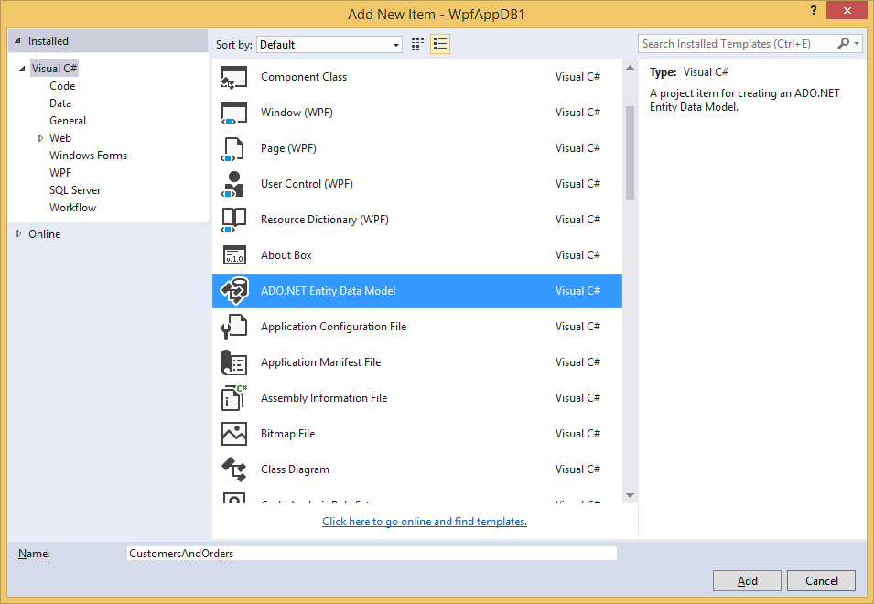
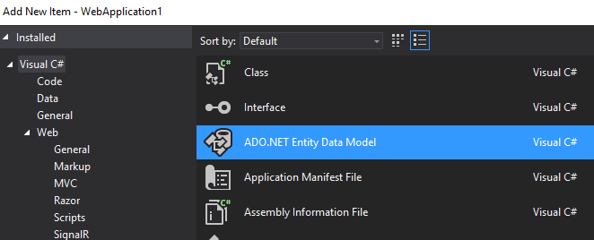
Adding an ADO.NET Entity Data Model
  Right-click on the Models folder
  Select Add New Item
  Select ADO.NET Entity Data Model (either from that menu or from the dialog shown here)
  No need to change the model name

Slide 28
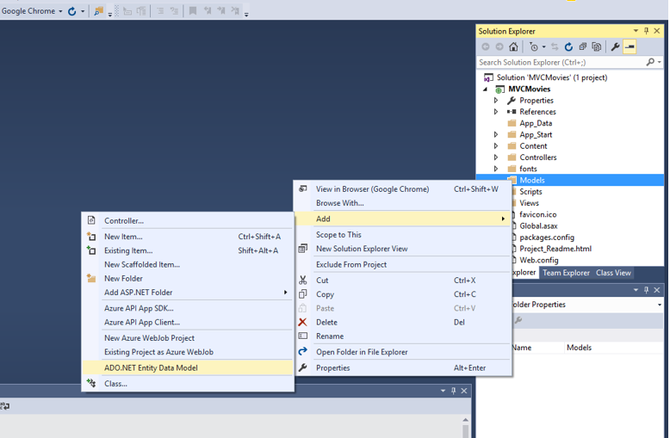
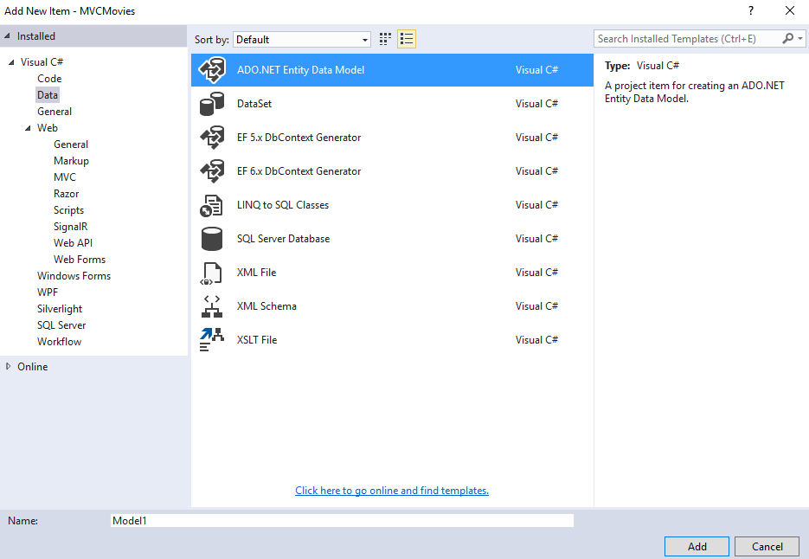
You will need to add an ADO.NET Entity Data model to your project to link your database to your project
  In the Solution Explorer, right-click on the Models folder
  Select Add New Item
  Select ADO.NET Entity Data Model from the menu
    If it’s not on the menu, select Add New Item and then select ADO.NET Entity Data Model from the dialog shown here (you may have to select Data on the left-hand side of the dialog)
  Click OK to start creating the model. There’s no need to change the model name

Slide 29
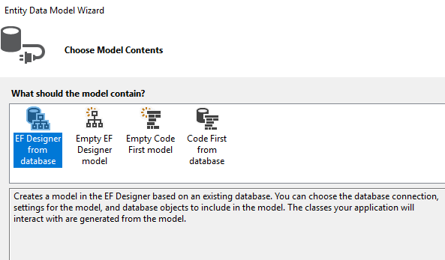
Select EF Designer

Slide 30
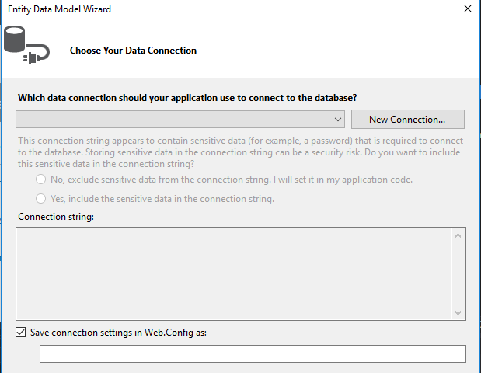
Add new Connection

Slide 31
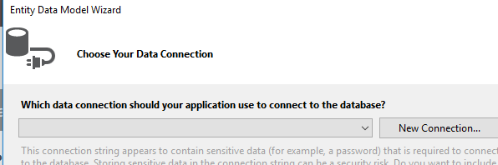
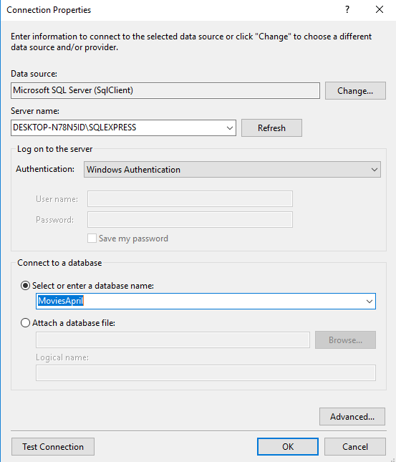
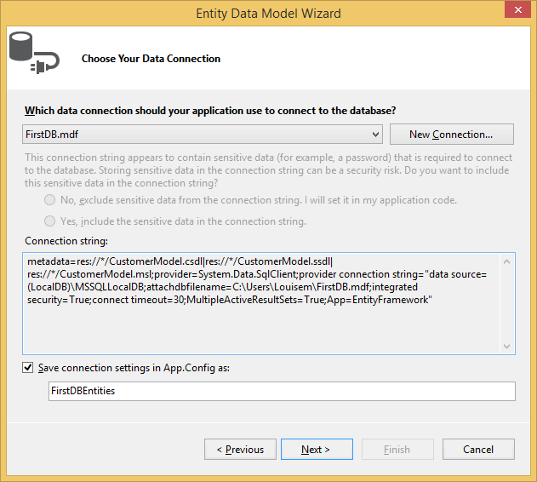
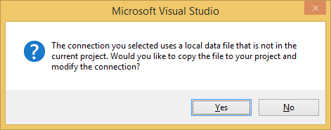
Connect to the SQL Database

Slide 32
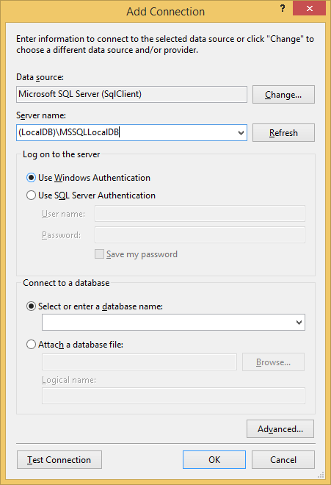
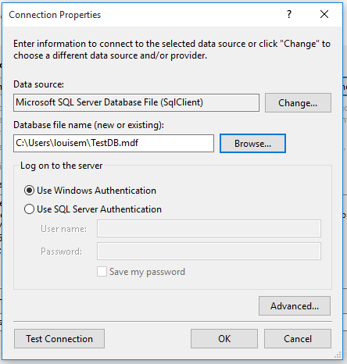
Two options for connecting to a DB here – try the one below first
Same DB as we used to
log in to SSMS
Put the DB filename here
Then click Test Connection – if you get a green tick, then click OK

Slide 33
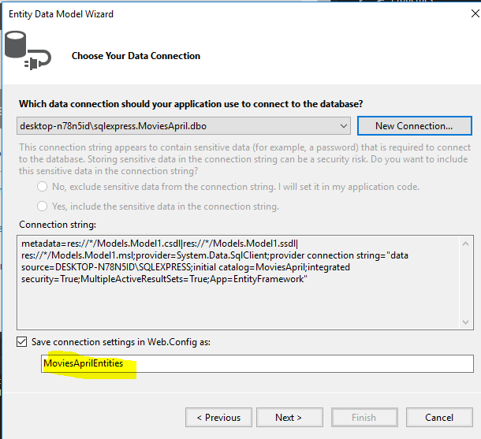
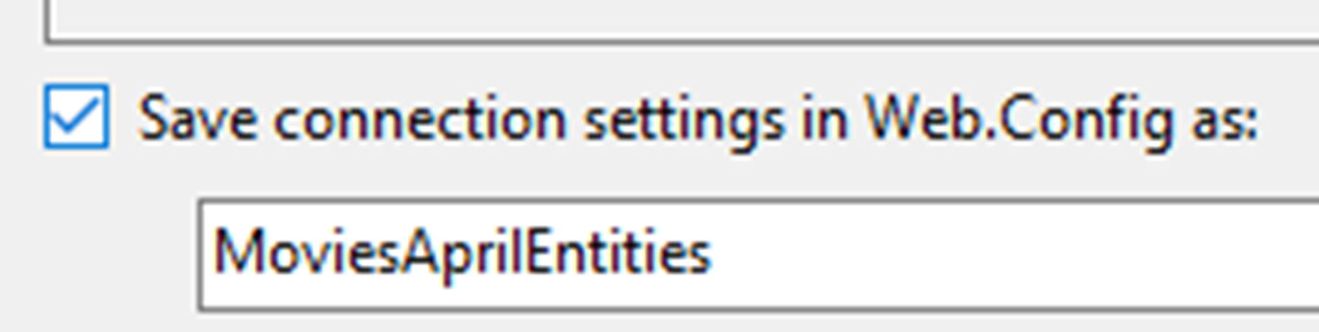
Entities Model created (DatabaseNameEntities)

Slide 34
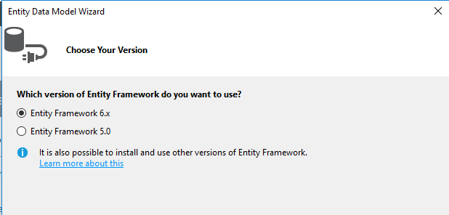
Select Framework

Slide 35
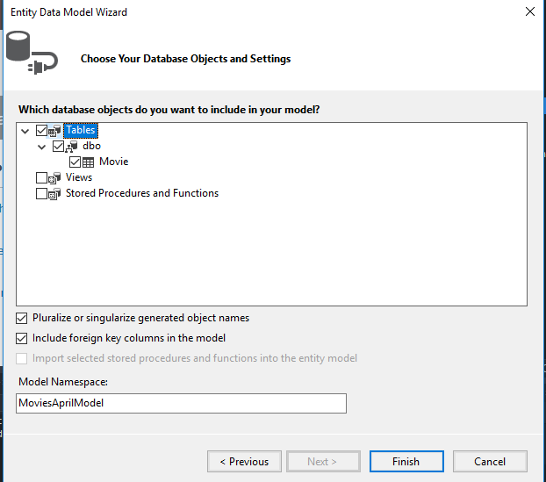

Select the Database Objects to be part of the model

Slide 36
ADO.Net Entity Model is then created
Checks
Model
Controller

Slide 37
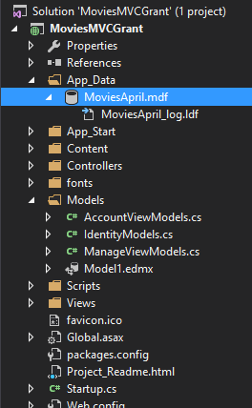
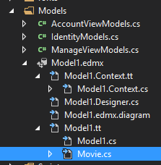
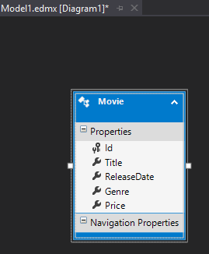
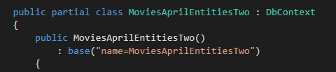

Slide 38
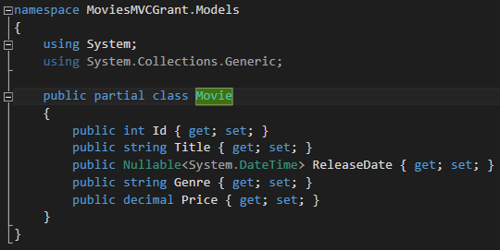
Movie

Slide 39
Database and Model now connected into the project and can be access through the codebase

Slide 40
Enable the Home Controller to access the Data Model

Slide 41
Controller can now link to the model
public class HomeController : Controller
{
//Set Access to the MoviesDB Entity and call it db
private MoviesAprilEntitiesTwo db = new MoviesAprilEntitiesTwo();

Slide 42
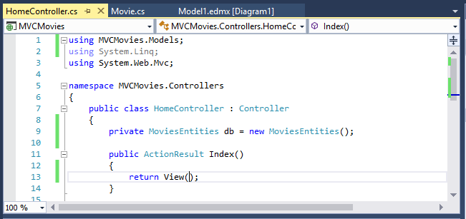
Adding a database connection object
To get ready to use the db
  Go into the Home Controller
  Add a using statement for the Models folder
  Declare a db connection object at the top of the Home Controller
    private MoviesEntities db = new MoviesEntities();
You can now write code to work with the database

Slide 43
If you need to change your database
It’s really common that, while developing an application, you realise that you need to change the design of your database
If you do want to change it, go back into SQL Server Management Studio (SSMS) and make the changes
  Make sure that you are working on the copy of your database in the App_Data folder of your project
  Sometimes SSMS stops you from changing table designs
    If that happens, go into Options, select Designers and uncheck the box that is labelled ‘Prevent saving changes that require table re-creation. You should then be able to save the changes to your table.
Close SSMS and go into Task Manager to shut down any SQL processes
Open Visual Studio and your project
Delete the existing model
  I know this sounds scary, but you are only deleting the connection to your database, not the database itself
Add a new model using your updated database file
Update the declaration of your database connection object in your Home Controller, to match the class set up by the new ADO.NET model – you will probably add a 1 to it

Slide 44
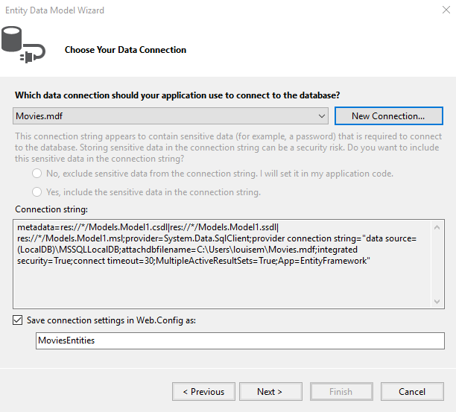
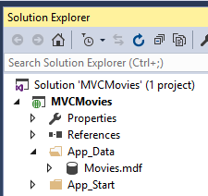

You will now go back to the Choose Your Data Connection screen
  PLEASE WAIT until the text in the box at the bottom has changed to MoviesEntities
  Make a note of this name, as you will use it in your code
  Click Next
  You will then see a dialog offering to copy your db file into the project
    Say yes – it keeps your db safely with the project
    Please remember that you now have 2 copies of your db and, if you go into SSMS to change it, you should use the copy that is now in the App_Data folder of your project

Slide 45
EXTRAS

Slide 46


ADO.NET EF model in Visual Studio

Slide 47

Entity Framework
ADO.NET should install this automatically, but it’s work checking the references to make sure
If you need to install it, go to the Tools menu and select the NuGet Package Manager
  Click Browse and type in Entity Framework
  Select Entity Framework on the left of the screen
  On the right of the screen, check the box next to your project
  Click install and wait until you see a message in the Output window saying that the installation has been successful
The NuGet Package Manager can also be used to install other useful packages, e.g. Bootstrap

Slide 48



Adding an ADO.NET Entity Data Model
The next screen is Choose Your Version
  Leave this unchanged and click Next
The next screen is Choose Your Database Objects and Settings
  Please expand the Tables node until you see the names of the Movie table
  Check the box next to the Movie table – if you don’t do this, there will be no table in your db
  Leave the other options unchanged and click Finish
ADO.NET will now import your db
  If you see any security warnings like this, just click OK

Slide 49


Adding an ADO.NET Entity Data Model
When the db has been added, you will see the db diagram showing the Movie table
You will also see a class for the Movie table if you expand the nodes in the Models folder
  The column names you set up in the database designer are now C# properties with the correct data types

Slide 50

Selecting the records from the database
In the Index action method you can now write a LINQ query to get all the records from the database
The results of the query should be passed to the View
The application now has the db data, but we need a View to see it
The code in the Index action method is:
public ActionResult Index()
{
var movies = from m in db.Movies
select m;
return View(movies);
}

Slide 51
The Views

Slide 53



Adding the Index View
To add a View, right-click on the method signature of the Index action method and choose Add View from the menu
In the Add View dialog, select:
  Empty template
  Movie as the model
  Leave everything else unchanged and click Add
If you get a message, asking if you want to replace the existing Index View, click Yes
  This is the default Index View created by Visual Studio, which we don’t need

Slide 54


Coding the Index View
You will see a View with a few lines of C# and HTML
Then add the code for the page and table headings (listed and explained on the next slide)

Slide 55
Coding the Index View
<h2>Movies</h2>
<table>
@*column headings for the table*@
<tr>
<th>
@Html.DisplayNameFor(model => model.Title)
</th>
<th>
@Html.DisplayNameFor(model => model.ReleaseDate)
</th>
<th>
@Html.DisplayNameFor(model => model.Genre)
</th>
<th>
@Html.DisplayNameFor(model => model.Price)
</th>
<th>
@Html.DisplayNameFor(model => model.ImageUrl)
</th>
</tr>
</table>
You can see that the View is very like a page of HTML
  You are creating an HTML table here
    <table> is the tag for the table
    <tr> is table row
    <th> is table header
All lines of C# start with a @, to tell the Razor View Engine that you have changed from HTML to C# (HTML tags tell Razor that you have changed back to HTML)
@Html.DisplayNameFor(model => model.Title) is an HTML helper
  HTML helpers are C# methods in MVC which take parameters and insert them into appropriate HTML for display in the browser

Slide 56
Coding the Index View
<h2>Movies</h2>
<table>
@*column headings for the table*@
<tr>
<th>
@Html.DisplayNameFor(model => model.Title)
</th>
<th>
@Html.DisplayNameFor(model => model.ReleaseDate)
</th>
<th>
@Html.DisplayNameFor(model => model.Genre)
</th>
<th>
@Html.DisplayNameFor(model => model.Price)
</th>
<th>
@Html.DisplayNameFor(model => model.ImageUrl)
</th>
</tr>
</table>
@Html.DisplayNameFor(model => model.Title) produces HTML when the application is run
  You will be able to see this in a few slides’ time when it’s possible to run this code without an error
@Html.DisplayNameFor is a strongly-typed HTML helper
  It is used in strongly-typed views
  By convention, strongly-typed HTML helpers have For in their names
  Many take a lambda expression as one of their parameters
  The field names in the lambda expression are from the Movie class, which was created when the database was attached to the project

Slide 57
Coding the Index View
<h2>Movies</h2>
<table>
@*column headings for the table*@
<tr>
<th>
@Html.DisplayNameFor(model => model.Title)
</th>
<th>
@Html.DisplayNameFor(model => model.ReleaseDate)
</th>
<th>
@Html.DisplayNameFor(model => model.Genre)
</th>
<th>
@Html.DisplayNameFor(model => model.Price)
</th>
<th>
@Html.DisplayNameFor(model => model.ImageUrl)
</th>
</tr>
</table>
model => model.Title is a lambda expression
  They are a form of anonymous function, but it’s a big topic and you don’t need to understand them for now, as you will only be using existing examples, not creating them yourself
@* *@ encloses a comment
If you run the code now, you will get an error
  You will find out now to fix this on the next slide

Slide 58



Coding the Index View
If you ran the code now, you would get this error
  There is a mismatch between the type of the data that we passed in from the Index action method in the Home Controller and the model statement at the top of the Index view
  This happens because we got some kind of list of data from the database query in the Index action method and passed this to the Index view
    The Index view is expecting a single Movie object as its input, not any kind of list
    The model statement at the top of the Index view makes this clear
      @model MVCMovies.Models.Movie says that a single object is expected
You want all the movies to be passed from the Index action method to the Index view, so you need to change the model statement to:
  @model IEnumerable<MVCMovies.Models.Movie>
  IEnumerable is an interface that all lists and collections inherit from, so this is an acceptable data type for passing in the Movies from the database query in the Index action method to the Index view

Slide 59


Coding the Index View
If you run the code now, you will see the page heading and the table headings
  The table headings show that some data is being successfully retrieved from the database
  It’s not properly formatted, but that can be done later when everything is working
You can also look in the developers’ tools (F12 in most browsers) to see the HTML that the Html.DisplayFor helper produced
  The HTML is quite simple – just the text of the column name – but there is quite also a bit of CSS added, such as text alignment and font weight

Slide 60

Coding the Index View
Now it’s time to do the rest of the table
  You need a foreach loop as there will be several rows in the table
    The IEnumerable that was added to the model statement is also essential for making the foreach loop work
  Each iteration of the foreach loop creates one row of the table
    <td> is the HTML tag for table data
    Html.DisplayFor is the strongly-typed Html helper that displays the contents of a field from a class
      It takes a lambda expression as a parameter and each lambda expression includes a field name from the Movie class
@foreach (var item in Model)
{
<tr>
<td>@Html.DisplayFor(m => item.Title)</td>
<td>@Html.DisplayFor(m => item.ReleaseDate)</td>
<td>@Html.DisplayFor(m => item.Genre)</td>
<td>@Html.DisplayFor(m => item.Price)</td>
<td>@Html.DisplayFor(m => item.ImageUrl)</td>
</tr>
}

Slide 61


Coding the Index View
If you run the code, you will now see the table, containing the data that you entered in SQL Server Management Studio
  This means that the database is being queried correctly
  The format is untidy, but this will be fixed later
  At the moment there is no data for the ImageUrl field, but this will be entered later
The HTML that is produced by the Html.DisplayFor helper is straightforward – just the contents of the fields in the Movie class
  The helper has allowed us to pass the data in to be rendered as HTML
  You will see more powerful uses of HTML helpers later in the tutorial

Slide 62



Coding the Index View
There are a few more things to do to finish the basic coding of the Index view:
  Adding a link for creating a new record
  Adding links for getting the details of a record or editing or deleting it
  Putting the application name on the menu bar, browser tab and footer
Link for creating a new record:
  In the Index view, under <h2>Movies</h2>, add an Html.ActionLink helper
    This creates an HTML anchor tag with the parameters entered
    The first parameter is the text for the link and the second parameter is the action method that the link will go to (this hasn’t been written yet)
    Run the code and you will see the link under the Movies page heading
    In developer tools, you can see that an HTML anchor tag has been created
@Html.ActionLink("Create new movie", "Create")

Slide 63


Coding the Index View
Links for getting the details of a record or editing or deleting it
  These will be added to each line of the table so it’s clear which record is being edited, deleted, etc.
  Add a new pair of <td> tags with 3 Html.ActionLink helpers inside them
  Each Html.ActionLink helper has 3 parameters:
    The text of the link
    The action method the link will go to (these haven’t been written yet)
    The id of the record that will be edited, deleted, etc.
  If you run the code now, you will see the 3 links next to each record in the table
<td>
@Html.ActionLink("Edit Record", "Edit", new { id = item.Id })
@Html.ActionLink("Details of Record", "Details", new { id = item.Id })
@Html.ActionLink("Delete Record", "Delete", new { id = item.Id })
</td>

Slide 64


Coding the Index View
If you go into developer tools in the browser, you will see that the URL in the anchor tag also includes the record id
  You will see that a different id has been retrieved for each record
  If you hover over the link in the browser you can also see the URL for the link in the bottom left hand corner of the screen

Slide 65



Coding the Index View
The last part of the content for the Index view is putting the application name into the menu, browser tab and footer
First, you need to know about the _Layout.cshtml file
The code for the menu bar is in the _Layout.cshtml file in the Views/Shared folder
The _Layout file contains any content that is shared between views, e.g.
  HTML headers
  Menus and footers
Any view can use the _Layout file
  They can reference it by adding: Layout = “~Views/Shared/_Layout.cshtml in the View
  If there is a _ViewStart.cshtml file in the Views folder, this contains the reference to _Layout.cshtml and views will pick this up by default, so the reference doesn’t have to be added to each view

Slide 66






Coding the Index View
The last part of the content for the Index view is putting the application name into the menu, browser tab and footer
In the _Layout.cshtml file:
  In the HTML <head> section, change <title> to:
    <title>Movies DB - @ViewBag.Title</title>
  In the HTML <body> section, in the <div class=navbar-header>, change the first parameter in the Html.Action link:
  @Html.ActionLink("Movies DB", “Index”, …
  In the <footer> section change the <p> content to:
  <p>&copy; @DateTime.Now.Year - Movies DB Ltd.</p>
Run the code to see the changes

Slide 67

The finished (for now) Index view
The content and functionality of the Index view are complete (styling and images will be done later) and it should look something like this:
The records in the database have been correctly retrieved and displayed
The links are in place. They don’t work at the moment – following any of them will cause an error – so the next thing is to write the action methods that the links should lead to – Create, Edit, Details and Delete

Slide 68
Create

Slide 69


Coding the Create view
For users to add records to the database, you will need a dialog that allows the information for each movie record to be added
This means starting with an action method, which will then call a view to display the dialog
Go to the Home Controller and add a Create action method below the Index action method using the code on the right
  This is a very simple action method that just returns a view
Then right-click on the action method signature and create a strongly typed view using the Movie model
  Make sure that ‘Use a layout page’ is selected

Slide 70
Coding the Create view
@using (Html.BeginForm())
{
<h4>Movie</h4>
@Html.LabelFor(m => m.Title)
@Html.EditorFor(m => m.Title)
@Html.LabelFor(m => m.ReleaseDate)
@Html.EditorFor(m => m.ReleaseDate)
@Html.LabelFor(m => m.Genre)
@Html.EditorFor(m => m.Genre)
@Html.LabelFor(m => m.Price)
@Html.EditorFor(m => m.Price)
@Html.LabelFor(m => m.ImageUrl)
@Html.EditorFor(m => m.ImageUrl)
<input type="submit" value="Create Movie" />
}
@Html.ActionLink("Back to List", "Index")
To allow users to add information through the view and pass it to the controller, a form is needed
  This is done with an Html.BeginForm helper
    By default, this returns information to an action method with the same name as the view and uses the POST method of communication
  The using statement means that any resources (e.g. memory) associated with the form are disposed of as soon as they are no longer needed
  The form must have a submit button and this can be an HTML button
Two other HTML helpers are used inside the form:
  Html.LabelFor is a strongly-typed helper that formats column headers as labels
  Html.EditorFor is a strongly-typed helper that accepts user input and assigns it to the corresponding fields in the model class (Movie)
There is also a link to return to the Index page

Slide 71
Coding the Create view
Now try entering some data into the Create view and clicking ‘Create Movie’
  Nothing is saved and the input fields go blank
At the moment, there is no code in the Home Controller that can save data, so you should do that next
Under the Create action method, add the code on the right
  The HttpPost annotation at the top of the action method tells MVC to use the HTTP POST request method to communicate with the server when executing this action method
  It’s fine to have two methods with the same name and return type because they have different parameters
    This is called overloading
  The data that was entered in the Create view is passed in the Movie object into the action method
  db.Movies.Add(movie) says that the movie should be added to the database the next time database changes are requested
[HttpPost]
public ActionResult Create(Movie movie)
{
db.Movies.Add(movie);
db.SaveChanges();
return RedirectToAction("Index");
}
db.SaveChanges() sends any pending database changes to the server
The return statement redirects users to a different action method and view (Index)
  The user is mostly like to want to see all the records after creating one

Slide 72


Coding the Create view
Run the code and you should now be able to add a record:
The Create view is finished (for now)
User input validation and styling will be added later

Slide 73
Edit

Slide 74


Coding the Edit view
The Edit view will allow users to edit records. It is quite similar to the Create view
You start by adding an Edit action method in the Home Controller, containing the code on the right:
  This action method receives a record id as an input parameter (passed by the Html.ActionLink(“Edit Record”, “Edit”, new {id = item.Id}) code in the Index view
  It uses the record id to look up the record in the database
  It sends the data to the Edit view
Right-click on the method signature and add a strongly-typed view with Movie as the model

Slide 75

Coding the Edit view
@using (Html.BeginForm())
{
<h4>Movie</h4>
@Html.LabelFor(m => m.Title)
@Html.EditorFor(m => m.Title)
@Html.LabelFor(m => m.ReleaseDate)
@Html.EditorFor(m => m.ReleaseDate)
@Html.LabelFor(m => m.Genre)
@Html.EditorFor(m => m.Genre)
@Html.LabelFor(m => m.Price)
@Html.EditorFor(m => m.Price)
@Html.LabelFor(m => m.ImageUrl)
@Html.EditorFor(m => m.ImageUrl)
<input type="submit" value=“Save Changes" />
}
@Html.ActionLink("Back to List", "Index")
To allow users to edit information in the view and pass it to the controller, add the code on the right
It is almost identical to the code in the Create view, so it’s easiest to copy that
  The only difference is that the text on the button is “Save Changes”
If you run the code with the Edit view visible on screen, you will get an error, as the URL doesn’t have a record id
Two workarounds are:
  Enter a valid record id in the URL
  Run from the Index page, so that the URL always has an id
There is also a fix for the problem – setting a start page

Slide 76


Setting a start page
Setting a start page will fix the problem of crashes caused by running the code from the wrong page
In the Solution Explorer right-click on the project name (the one in bold)
  From the menu select Properties
  When the Properties dialog opens
    Select Web from the list on the left
    Set the start action as Specific Page
      Leave the input box blank, as it will use MVC routing and default to Home/Index
  Save the change (Ctl+S)
Now the project will always start from the Index page

Slide 77

Coding the Edit view
Run the code and it will now start with the Index view. If you navigate to the Edit view, you should see something like this:
If you look at the URL, you can see the record id
Data for that record has been retrieved from the database, ready for editing
If you try to make a change, it won’t work yet, as there isn’t any code for changing records in the database
The HTML that has been created by each helper is the same as in the Create View

Slide 78
Coding the Edit view
A POST action method for editing is needed in the Home Controller to allow edits to be saved
  The code for this is on the right
  It’s similar to the POST action method for Create, except for the line:
    db.Entry(movie).State = EntityState.Modified
    This modifies the existing record with the changes that were passed into the action method by the form in the view
    You will also need to add:
      using System.Data.Entity at the top of the Home Controller
Now you should be able to edit a record
using System.Data.Entity;
[HttpPost]
public ActionResult Edit(Movie movie)
{
db.Entry(movie).State = EntityState.Modified;
db.SaveChanges();
return RedirectToAction("Index");
}

Slide 79


Coding the Edit view
Run the code and you should now be able to edit a record:
The Edit view is finished (for now)
User input validation and styling will be added later

Slide 80
Details

Slide 81

Coding the Details view
public ActionResult Details(int id)
{
Movie movie = db.Movies.Find(id);
return View(movie);
}
It would be helpful if users could look at the details of movies, so you will create a Details view next
Start in the Home Controller and add a Details action method, using the code on the right
  It’s very similar to the GET Edit action method, because it’s doing the same thing – accepting a record id, fetching the record from the database and passing the record data to a view
Then right-click on the method signature and add a strongly-typed view called Details with Movie as the model

Slide 82
Coding the Details view
The Details view simply displays the details of the movie and doesn’t allow editing
Please add the code on the right to the Details view, just below the <h2>Details</h2> heading
There are some new HTML tags here:
  <dl> - description list
  <dt> - description term (i.e. title of the data item in the list)
  <dd> - description (i.e. the content of each field)
  The <dt> and <dd> tags don’t do much, but you can apply CSS to style your list
All the HTML helpers are familiar, as they were used in the Index view
Since there is no user input, there is no need for a POST action method in the Home Controller
<h4>Movie</h4>
<dl>
<dt>@Html.DisplayNameFor(m => m.Title)</dt>
<dd>@Html.DisplayFor(m => m.Title)</dd>
<dt>@Html.DisplayNameFor(m => m.ReleaseDate)</dt>
<dd>@Html.DisplayFor(m => m.ReleaseDate)</dd>
<dt>@Html.DisplayNameFor(m => m.Genre)</dt>
<dd>@Html.DisplayFor(m => m.Genre)</dd>
<dt>@Html.DisplayNameFor(m => m.Price)</dt>
<dd>@Html.DisplayFor(m => m.Price)</dd>
</dl>
<p>
@Html.ActionLink("Edit Record", "Edit", new { id = Model.Id }) |
@Html.ActionLink("Back to List", "Index")
</p>

Slide 83

Coding the Details view
Run the code and select Details of Record in the Index view. You should now be able to see the details of a record:
This Details view isn’t very exciting, because it just repeats the information in the Index view, but in your own projects you can make it more interesting, e.g. with extra information, pictures or videos
The Details view is finished (for now)
Styling will be added later

Slide 84
Delete

Slide 85

Coding the Delete view
public ActionResult Delete(int id)
{
Movie movie = db.Movies.Find(id);
return View(movie);
}
It would be helpful if users could delete a movie, so you will create a Delete view next
Start in the Home Controller and add a Delete action method, using the code on the right
  It’s very similar to the GET Edit and Details action methods, because it’s doing the same thing – accepting a record id, fetching the record from the database and passing the record data to a view
Then right-click on the method signature and add a strongly-typed view called Delete with Movie as the model

Slide 86
Coding the Delete view
The Delete view offers the user the option of deleting the record
  It also displays the details of the movie but doesn’t allow editing
    That part of the code is identical to the Details view, so can be copied from there
  There is also a form which passes the id of the record to the Home Controller for deletion
    There is no need to pass the data, as the record is not being added or changed
Please add the code on the right to the Delete view, just below the <h2>Delete</h2> heading
All the HTML tags and helpers are familiar, as they were used in the Index or Details views
<h3>Are you sure you want to delete this?</h3>
<h4>Movie</h4>
<dl>
<dt>@Html.DisplayNameFor(m => m.Title)</dt>
<dd>@Html.DisplayFor(m => m.Title)</dd>
<dt>@Html.DisplayNameFor(m => m.ReleaseDate)</dt>
<dd>@Html.DisplayFor(m => m.ReleaseDate)</dd>
<dt>@Html.DisplayNameFor(m => m.Genre)</dt>
<dd>@Html.DisplayFor(m => m.Genre)</dd>
<dt>@Html.DisplayNameFor(m => m.Price)</dt>
<dd>@Html.DisplayFor(m => m.Price)</dd>
</dl>
@using (Html.BeginForm())
{
<input type="submit" value="Delete Record" />
}
@Html.ActionLink("Back to List", "Index")

Slide 87

Coding the Delete view
Run the code and select Delete Record in the Index view. You should now be able to see the details of a record:
Deletion won’t work yet, as you need to return to the Home Controller and write a POST Delete action method to implement it

Slide 88
Coding the Delete view
In the Home Controller, add an action method called Delete with an integer parameter called id
  You will see that there is a problem, because there is already an action method with the same signature
  MVC offers a way around this:
    Change the name of the second Delete action method to something else (e.g. DeleteConfirmed) and add an annotation [ActionName(“Delete”)] above the method
    This makes sure that MVC can call this method when it is looking for a Delete action method
Next, add HttpPost inside the square brackets for the annotation, as this is a POST method that will change the contents of the database
Then, add the rest of the code on the right. This code
  Uses the record id to find the record
  Marks it for deletion
  Saves changes to the database
  Returns the user to the Index view
[HttpPost, ActionName("Delete")]
public ActionResult DeleteConfirmed(int id)
{
Movie movie = db.Movies.Find(id);
db.Movies.Remove(movie);
db.SaveChanges();
return RedirectToAction("Index");
}

Slide 89

Coding the Delete view
Now delete a record
  Check the Index view to confirm that it has gone

Slide 90
CRUD

Slide 91
Your CRUD database is working
You now have a working database application in MVC that has CRUD functionality. It can display, create, edit and delete records
In the second part of this tutorial, you will learn how to add user input validation and filtering, do some styling and render URLs as images

